Slide 1


Overview of Object Tracking
NGUYEN MANH TUAN
www.solutions.viettel.vn
Notes:
1

Slide 2

01 INTRODUCTION
02 EVOLUTION OF TECHNOLOGY
03 DATASET & EVALUTION METRICS
04 SORT ALGORITHM
05 DEMO CODE
AGENDA
www.viettel.com.vn
Notes:
2

Slide 3

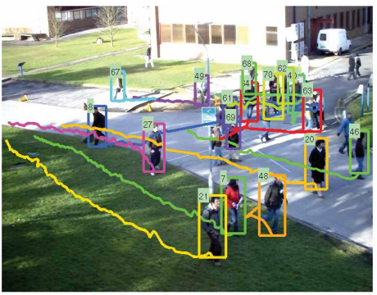
1. INTRODUCTION
Be a classic research direction in the field of computer
Aims at estimating bounding boxes and the identities of objects in videos
Real-world applications:
Surveillance
Retail
Autonomous Vehicles
Smart Traffic
Fig 1. Example of Object Tracking [1]
www.viettel.com.vn
Notes:
With the continuous progress of science and technology, the demand of people for visual object tracking is also increasing. The objects to be tracked changes from rigid objects to non-grid objects. The background of video is from simple to complex, such as occlusion, motion blur and some other complex situations. Besides, the demand for tracking time also grows. The essence of visual object tracking is an online learning problem with the small size of non-annotated samples: How to construct a robust representation model, fast motion model and effective update model is the mainly challenge in visual object tracking. In addition, tracking tasks are more and more close to the real life.
Giám sát an ninh:
Phát hiện đối tượng người|động vật vào vùng cấm, giãn cách xã hội, phát hiện đám đông
Bán lẻ:
Đếm số lượng khách hàng
Amazon Go Grocery: siêu thị không người bán đầu tiên trên TG
Xe tự hành:
phát hiện chướng ngại vật, phát hiện người đi bộ, ước tính quỹ đạo, tránh va chạm, ước tính tốc độ xe, giám sát giao thông và ước tính tuyến đường.
Giao thông:
bắt vi phạm: vượt đèn đỏ, sai làn, v.v.
3

Slide 4
1. INTRODUCTION
There are multiple tracking challenges
Wu et al [2] divided the challenges existing into 11 categories:
Background Clutter Illumination Variation Occlusion Scale Variation Deformation Motion Blur | In-Plane Rotation Out-of-Plane Rotation Out-of-View Low Resolution Fast Motion
www.viettel.com.vn
Notes:
Scale Variation, SV SV refers to the situation in which the ratio of the bounding box in the initial frame to the bounding box in current frame exceeds a specific threshold
Illumination Variation, IV IV refers to the situation in which the illumination of the object region changes significantly as the video plays
Occlusion, OCC OCC refers to the situation in which the object is partially or completely occluded as the video plays,
Deformation, DEF DEF refers to the situation in which the shape of the object change significantly compared to the initial frame.
Motion Blur, MB MB refers to the situation that the object image is blurred due to the movement of the object or the shake of camera,
Fast Motion, FM FM refers to the situation that the distance of the objects between two adjacent frames is over a certain threshold tm
In-Plane Rotation, IPR TPR refers to the rotation of the object in image plane when the video plays, as shown in Fig
Out-of-Plane Rotation, OPR OPR refers to the rotation of the object out of the image plane when the video plays, as shown in
Out-of-View, OV OV refers to the situation that the object appears at the boundary of the frame and some parts of the object jump out of this frame,
Background Clutters, BC BC refers to the situation that there are some similar objects around the object to be tracked
Low Resolution, LR LR refers to the case that the number of the pixels in object bounding box does not exceed a certain threshold tr.
4

Slide 5
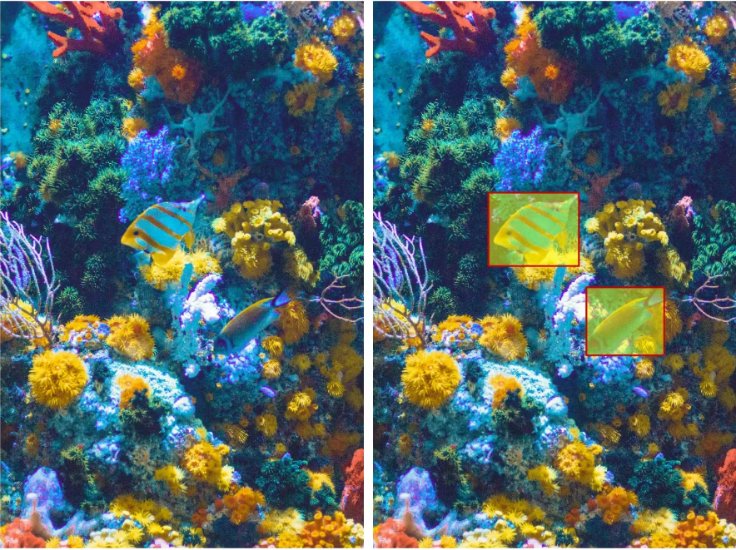
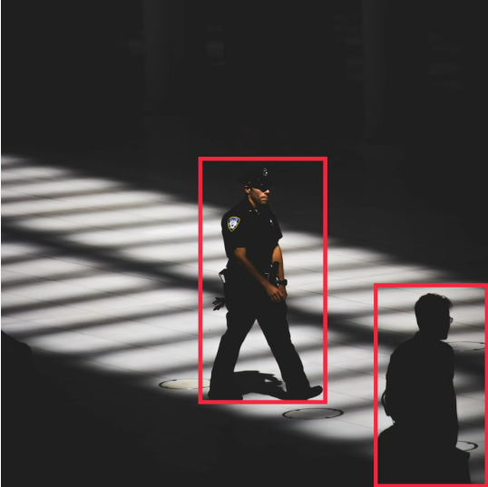
1. INTRODUCTION
Fig 2. Example of Background Clutter [3]
Fig 3. Example of Illumination Variation [3]
www.viettel.com.vn
Notes:
Background Clutter:
It is difficult to extract features, detect or even track a target object when the background is densely populated, as it introduces more redundant information or noise, making the network less receptive to important features.
Illumination Variation:
In a real-life scenario, the illumination on an object of interest changes drastically as the object moves – making its localization more challenging to track and estimate.
5

Slide 6
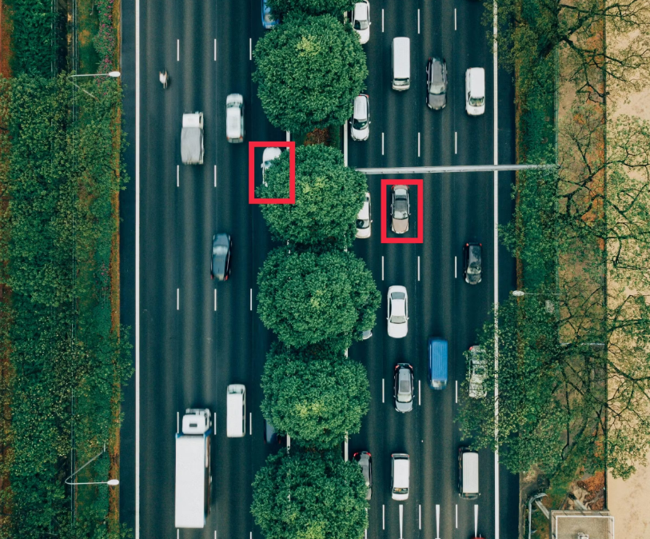
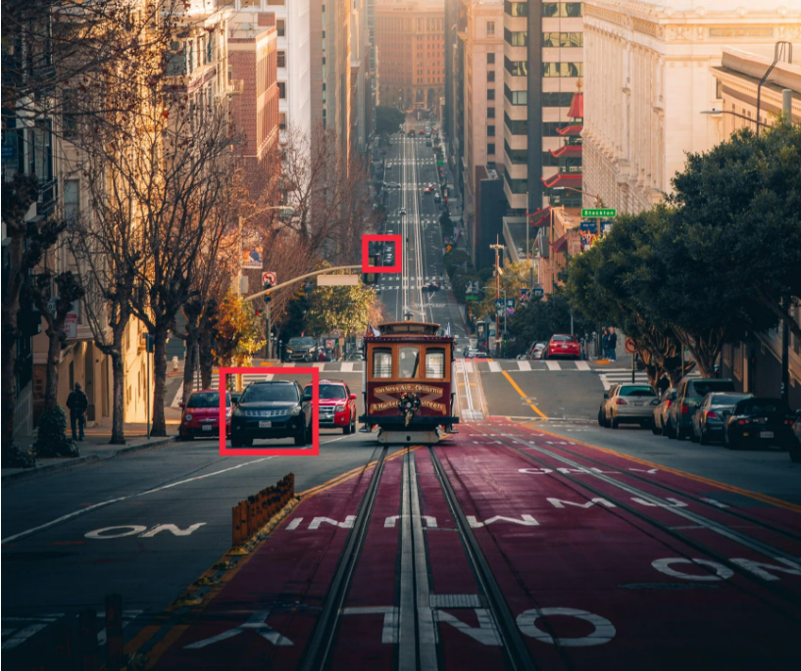
1. INTRODUCTION
Fig 4. Example of Occlusion [3]
Fig 5. Example of Scale Variation [5]
www.viettel.com.vn
Notes:
Occlusion:
As different objects and bodies enter and leave the frame, the target object’s bounding box is often occluded – preventing the algorithm from being able to identify and track it, as the background or foreground are interfering. This often happens when the bounding boxes of multiple objects come too close together, causing the algorithms to get confused, and identify the tracked object as a new object.
Scale Variation:
Scale is also a factor, and the algorithm’s ability to track the target object can be challenged when the bounding boxes of the first frame and the current frame are out of the range.
6

Slide 7
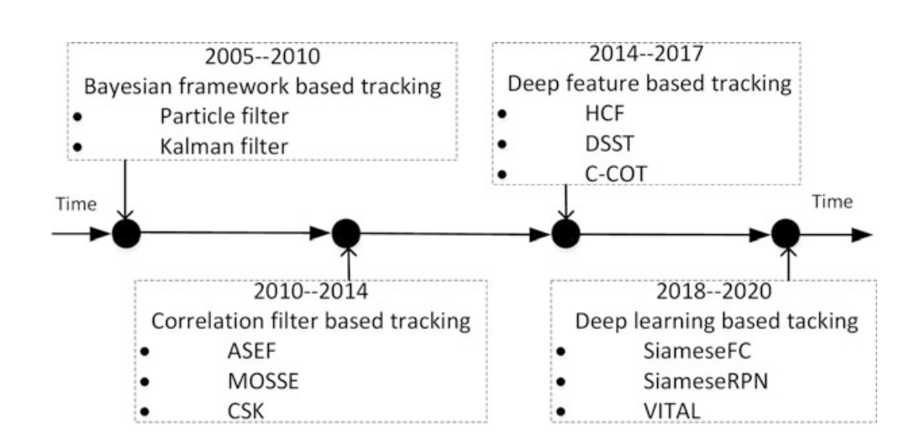
2. EVOLUTION OF TECHNOLOGY
The evolution of visual object tracking technology can be simply summarized by Fig 6 below:
Fig 6. The evolution of visual object tracking [4]
www.viettel.com.vn
Notes:
From 2005 to 2010, visual object tracking methods are mainly based on the Bayesian framework, Particle filter, and Kalman filter, which are generative methods. During this period, visual object tracking is mainly considered as a template matching problem
From 2010 to 2014, the correlation filtering based trackers with kernel methods which belongs to the discriminative methods are widely studied by researchers[50– 54]. The purpose of correlation filtering based trackers is to train a correlation filter which could make the object center locate at the peak value in the response map after the correlation filtering operation.
2015 – 2017 Because of the powerful representation ability of deep feature, deep feature is merged into the correlation filtering based trackers during 2015 and 2017 [55–57]. Well pre-trained networks are used as feature extractors. Ma et al. [55] applied a pretrained deep network to extract the deep feature of the object and combined multi-features from feature maps of different layers in deep network to construct the proposed HCF tracker
From 2018 to 2020, along with the development of deep network, deep learning based tracking methods also get rapid developments, especially the Siamese network which obtained a remarkable performance in visual object tracking
7

Slide 8
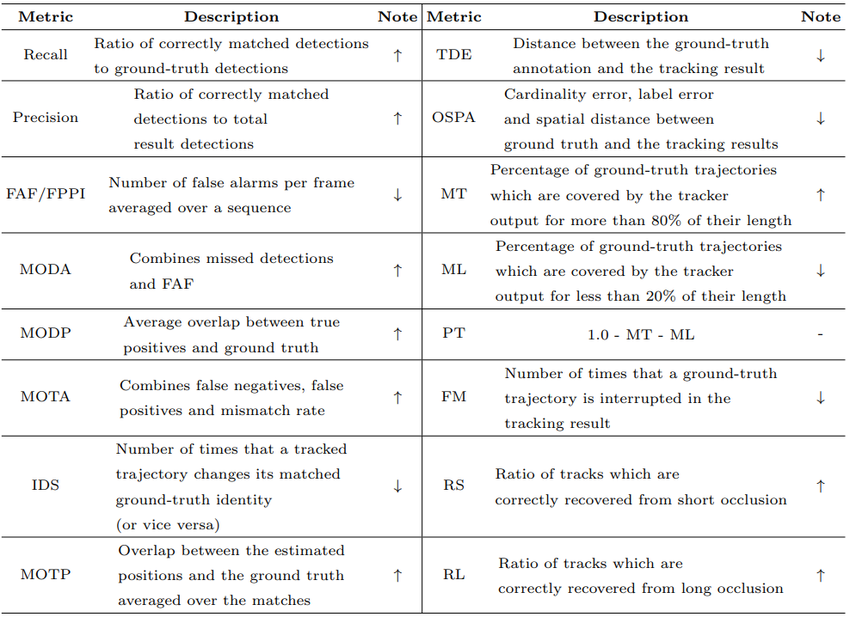
3. DATASET & EVALUTION METRIC
Fig 7. An overview of evaluation metrics for MOT [5]
www.viettel.com.vn
Notes:
False Alarms per Frame (FAF) Multiple Object Tracking Precision (MOTP)
False Positive Per Image (FPPI) Multiple Object Tracking Precision (MOTP)
The Multiple Object Detection Precision (MODP) The numbers of Mostly Tracked (MT)
Multiple Object Detection Accuracy (MODA) Partly Tracked (PT)
Multiple Object Detection Precision Mostly Lost (ML)
ID switches Fragmentation (FM)
Multiple Object Tracking Accuracy (MOTA) Recover from Short-term occlusion (RS)
Recover from Long-term occlusion (RL)
8

Slide 9
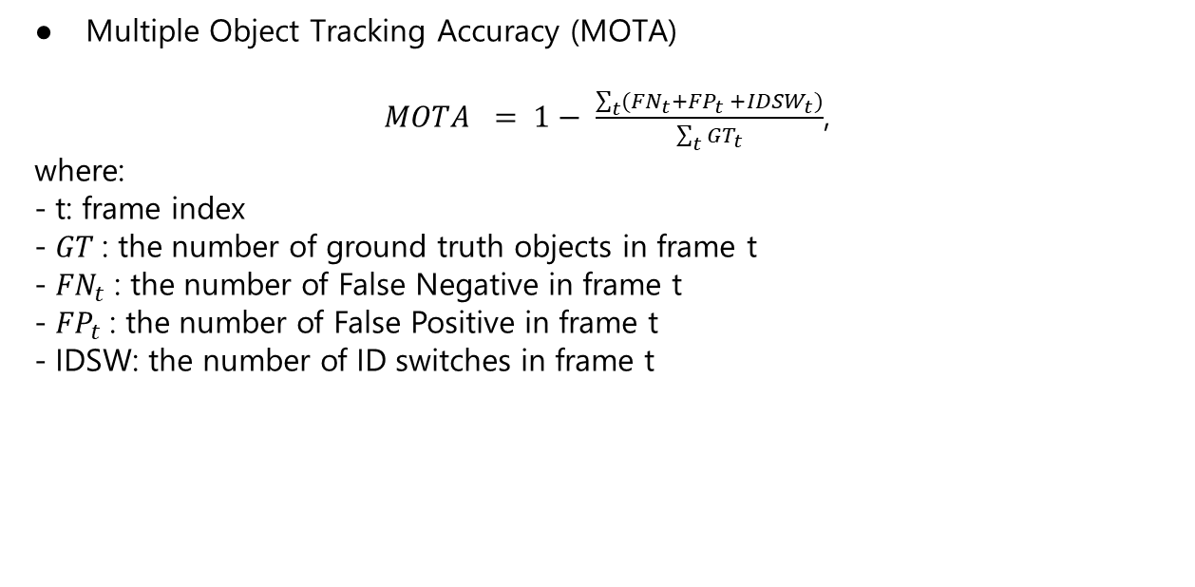
3. DATASET & EVALUTION METRIC
Multiple Object Tracking Accuracy (MOTA)
$MOTA = 1− \frac{\sum_{t}{({FN}_{t}+{FP}_{t} +{IDSW}_{t})}}{\sum_{t}{{GT}_{t}}}$,
where:
- t: frame index
- $GT$: the number of ground truth objects in frame t
- ${FN}_{t}$: the number of False Negative in frame t
- ${FP}_{t}$: the number of False Positive in frame t
- IDSW: the number of ID switches in frame t
www.viettel.com.vn
Notes:
False Negative: miss track
False Positive:
9

Slide 10
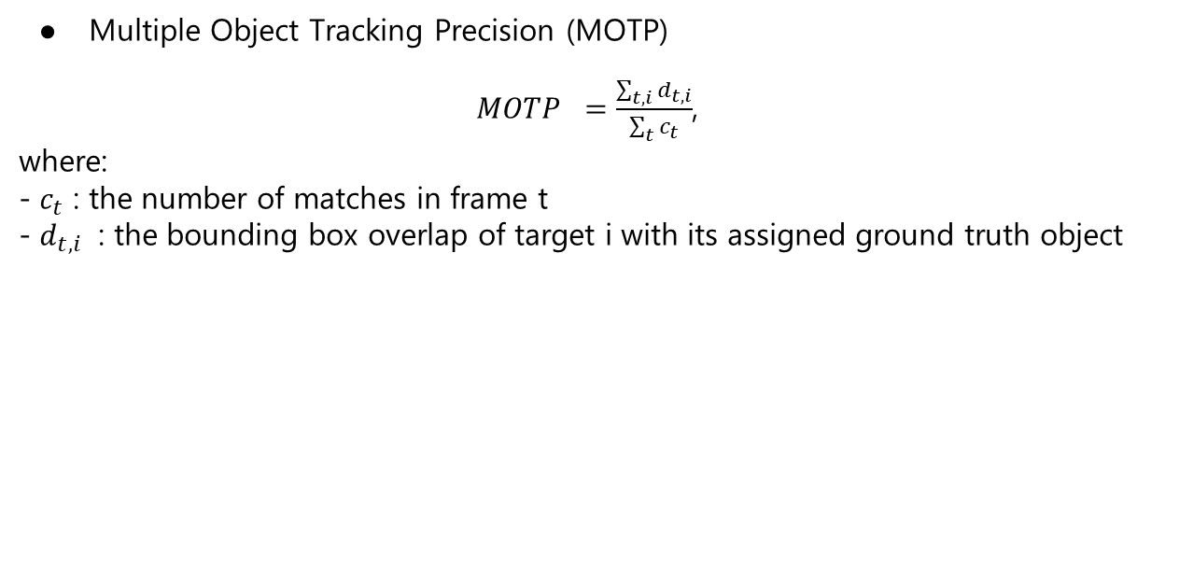
3. DATASET & EVALUTION METRIC
Multiple Object Tracking Precision (MOTP)
$MOTP =\frac{\sum_{t,i}{d_{t,i}}}{\sum_{t}{c_{t}}}$ ,
where:
- $c_{t}$: the number of matches in frame t
- $d_{t,i}$: the bounding box overlap of target i with its assigned ground truth object
www.viettel.com.vn
Notes:
It is important to point out that MOTP is a measure of localization precision, not to be confused with the positive predictive value or relevance in the context of precision / recall curves used, e.g., in object detection. In practice, it mostly quantifies the localization accuracy of the detector, and therefore, it provides little information about the actual performance of the tracker
10

Slide 11
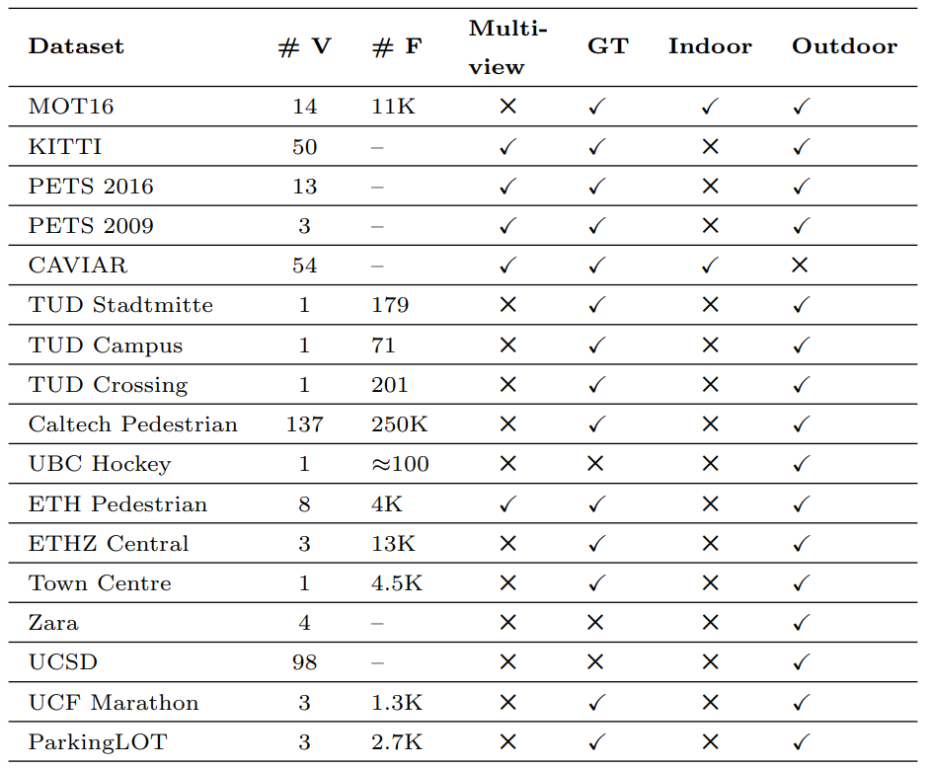
3. DATASET & EVALUTION METRIC
Fig 8. Statistics of publicly available datasets [5]
www.viettel.com.vn
Notes:
There are several variants of the dataset released each year, such as MOT15, MOT17, MOT20.
# V and # F mean how many videos and frames are included in the dataset.
11

Slide 12
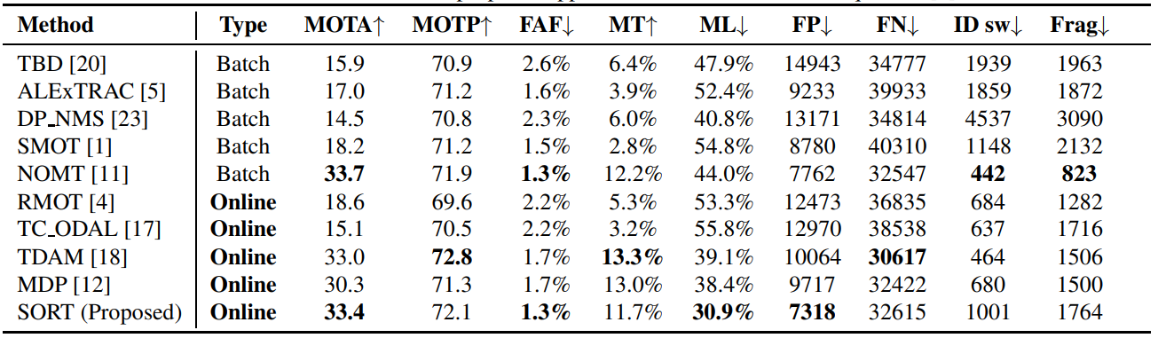
4. SORT ALGORITHM
- Release in 2016 by Bewley et al, as the SOTA online trackers.
- Using combination of Kalman Filter and Hungarian Algorithm
- The tracker updates at a rate of 260 Hz which is over 20x faster than other SOTA
Fig 9. Performance of SORT on MOT15 [6]
www.viettel.com.vn
Notes:
Slide này giới thiệu tổng quan về nền tảng: nền tảng đó là gì, giúp người dùng làm gì và đem lại lợi ích như nào, …
Liệt kê các key word giới thiệu nổi bật nhất về nền tảng
12

Slide 13
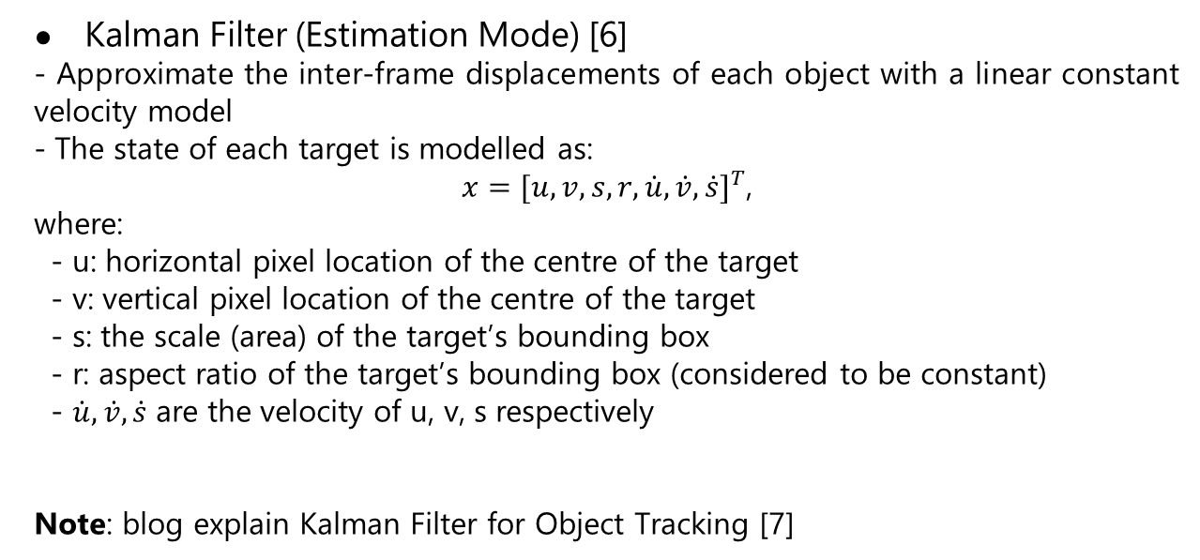
4. SORT ALGORITHM
Kalman Filter (Estimation Mode) [6]
- Approximate the inter-frame displacements of each object with a linear constant velocity model
- The state of each target is modelled as:
$x=[u, v, s, r, \dot{u},\dot{v},\dot{s}]^{T}$,
where:
- u: horizontal pixel location of the centre of the target
- v: vertical pixel location of the centre of the target
- s: the scale (area) of the target’s bounding box
- r: aspect ratio of the target’s bounding box (considered to be constant)
- $\dot{u},\dot{v},\dot{s}$ are the velocity of u, v, s respectively
Note: blog explain Kalman Filter for Object Tracking [7]
www.viettel.com.vn
Notes:
Là một mô hình một mô hình Linear-Gaussian State Space Mode, lần đầu ra mắt năm 1960
https://towardsdatascience.com/what-i-was-missing-while-using-the-kalman-filter-for-object-tracking-8e4c29f6b795?gi=ae3ad7298044
13

Slide 14
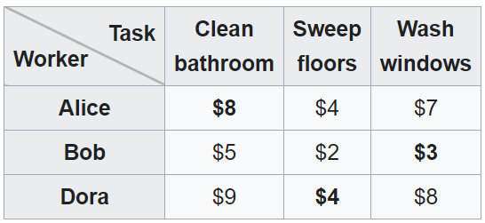
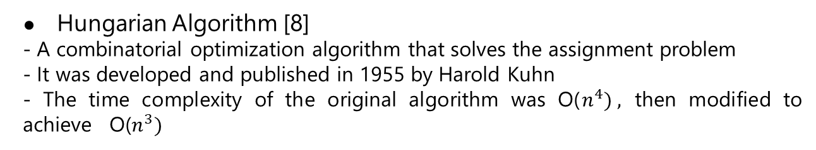
4. SORT ALGORITHM
Hungarian Algorithm [8]
- A combinatorial optimization algorithm that solves the assignment problem
- It was developed and published in 1955 by Harold Kuhn
- The time complexity of the original algorithm was O($n^{4}) ,$ then modified to achieve O($n^{3})$
Fig 10. Example of Assignment problem [8]
www.viettel.com.vn
Notes:
Harold Kuhn gave the name "Hungarian method" because the algorithm was largely based on the earlier works of two Hungarian mathematicians: Dénes Kőnig and Jenő Egerváry.^{[1][2]}
The assignment cost matrix is then computed as the IOU distance between each detection and all predicted bounding boxes from the existing targets
14

Slide 15
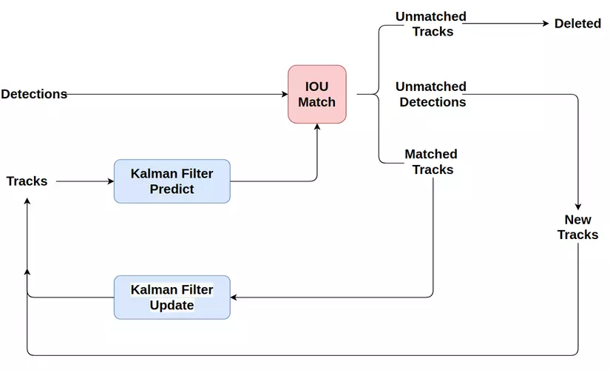
4. SORT ALGORITHM
METHODOLOGY
SORT is described by the key components:
- Detection
- Estimation Model:
+ propagating object states into future frames
- Data Association:
+ associating current detections with existing objects
- Creation and Deletion of Track Identities:
+ managing the lifespan of tracked objects.
Fig 11. The modeling of the SORT algorithm [9]
www.viettel.com.vn
Notes:
15

Slide 16
REFERENCES
[1] | Xiang, Y., Alahi, A., & Savarese, S. (2015). Learning to track: Online multi-object tracking by decision making. In Proceedings of the IEEE international conference on computer vision (pp. 4705-4713).
[2] | Wu, Y., Lim, J., Yang, M.: Online object tracking: a benchmark. In: IEEE Conference on Computer Vision and Pattern Recognition, pp. 2411–2418 (2013)
[3] | https://encord.com/blog/object-tracking-guide/
[4] | Xing, Weiwei, et al. Visual Object Tracking from Correlation Filter to Deep Learning. Springer, 2021.
[5] | Luo, Wenhan, et al. "Multiple object tracking: A literature review." Artificial intelligence 293 (2021): 103448.
[6] | Bewley, Alex, et al. "Simple online and realtime tracking." 2016 IEEE international conference on image processing (ICIP). IEEE, 2016
www.viettel.com.vn
Notes:
16

Slide 17
REFERENCES
[7] | https://towardsdatascience.com/what-i-was-missing-while-using-the-kalman-filter-for-object-tracking-8e4c29f6b795?gi=ae3ad7298044
[8] | https://en.wikipedia.org/wiki/Hungarian_algorithm
[9] | https://encord.com/blog/object-tracking-guide/
www.viettel.com.vn
Notes:
17

Slide 18

THANK YOU
www.viettel.com.vn

